Slide 1
2. The Object Model

Slide 2
Elements of the Object Model
Kinds of Programming Paradigms:
Jenkins & Glasgow observe that -
  Most programmers work in one language and use only one programming style.
  They program in a paradigm enforced by the language they use.
  Frequently they have not been exposed to alternate ways of thinking about a problem and
  Hence have difficulty in seeing the advantage of choosing a style more appropriate to the problem at hand.

Slide 3
Bobrow and stefik define a programming style as –
  a way of organizing programs on the basis some conceptual model of programming and an appropriate language to make programs written in the style clear.
They further suggest that there are five main kinds of programming styles:
  Procedure-oriented – used algorithms only = best for the design of computation-intense operations.
  Object-oriented – used classes and objects = best for broadest set of applications.

Slide 4
  Logic-oriented – Goals, often expressed in a predicate calculus.
  Rule-oriented – if-than rules = best for the design of a knowledge base.
  Constraints-oriented – Invariant relationships

Slide 5
In computing, object model has two related but distinct meanings:
The properties of objects in general, in a specific computer programming language, technology, notation or methodology that uses them. For example, the Java object model, the Component Object Model(COM), or the object model of Object Modeling Technique OMT). Such object models are usually defined using concepts such as class, message, inheritance, polymorphism, and encapsulation. There is an extensive literature on formalized object models as a subset of the formal semantics of programming languages.

Slide 6
A collection of objects or classes through which a program can examine and manipulate some specific parts of its world. In other words, the object-oriented interface to some service or system. Such an interface is said to be the object model of the represented service or system. For example, the Document Object Model (DOM) is a collection of objects that represent a page in a web browser, used by script programs to examine and dynamically change the page. There is a Microsoft Excel object model for controlling Microsoft Excel from another program, and the (AStronomy Common Object Model) ASCOM Telescope Driver is an object model for controlling an astronomical telescope.

Slide 7
There are four major elements of this object model:
  Encapsulation
  Abstraction
  Modularity
  Hierarchy
There are another three minor elements of the object model:
1. Typing
2. Concurrency
3. Persistence

Slide 8
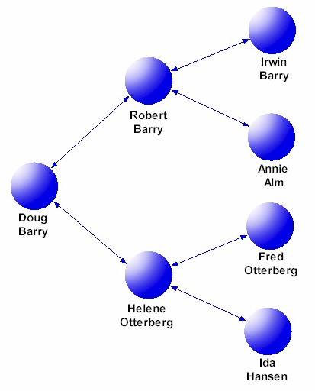
Abstraction
Abstraction is the process of distilling the data down to its essential.
But in Object Schema, the abstract data model is implemented as a graph.
The following figure shows such a graph structure for a genealogical database

Slide 9
Abstraction
Consider a real-world objects such as radio.
As far as a user is concerned, the radio is one unit.
In reality, it consists of many units, e.g., Station Management, Power-management, and Volume Control.
However, the user is not intimidated by all these complex subunits and their working.
To him, the radio should work as one abstract unit ( with external buttons to represent these sub-units).
Similarly a class is one abstract unit. In order to perform a task that involve an object of the class, a message must be sent to the object asking it to execute the desired operation.

Slide 10
Abstraction
Abstraction is the process of modeling only relevant features
  Hide unnecessary details which are irrelevant for current purpose (and/or user), like eye color
Reduces complexity and aids understanding
Done via class, inheritance, association, and aggregation concepts
Questions:
1. Define the kinds of Abstractions.

Slide 11
Encapsulation
Encapsulation is the process of compartmentalization the elements of an abstraction that constitute its structure and behavior.
Encapsulation is an attribute of object design.
Encapsulation serves to separate the interface of an abstraction and its implementation.
So, encapsulation is the integration addition/combination of data and operations into a class
Supports information hiding by concealing implementation of the object.

Slide 12
Allows us to call a function without knowing, or caring, how it’s implemented
  sqrt(x)
The instructions are encapsulated within a function.
Programming languages aren’t quite so strict and allow differing levels of access to the object’s data. So, includes three levels of access in programming:
  Public = All Objects can access it
  Private = Access is limited to member of the same class.
  Protected = Access is limited to member of the same class.

Slide 13
In OO, a class is used as a unit to group related attributes and operations together.
Interact with the data stored in the variables that represent the attributes of the class only through the operations of that class.
So, Encapsulation is the grouping of related ideas into one unit, which can thereafter be referred to by a single name.

Slide 14
Thus the operations act as interfaces of the object of the class. For example:
Employee
Here the class is the employee
getEmpID()
setEmpID()
empID
empName
dateOfJoining
setEmpName()
getDOJ()
getEmpName()
setDOJ()

Slide 15
So, the employee class have the following operations:
setEmpID(employeeid:int) = assigns employee to empID
getEmpID():int = returns the value of empID
setEmpName(employeename:string)= assigns employeename to
empName
getEmpName():String = returns the name of the employee
setDOJ(doj:date) = assign doj to date of joining
getDOJ:date = returns the date of joining
For an object e1 of the type Employee, if it is necessary to set any value to attributes; then the methods – setEmpID(employeeid:int) ……………….. must be used.
Similarly, necessary to know the value of any attributes, then the get operations have to be used.
So, these operations act as the interface of the object e1 with the outside world.
Thus, the attributes and operations are encapsulated within a class, and interaction with the attributes is done through the interface which is provided by the enacpsulation.

Slide 16



Principle of Abstraction
A process allowing to focus on most important aspects while ignoring less important details.
Abstraction allows us to manage complexity by concentrating on essential aspects making an entity different from others.
Salesman
Product
Customer
An example of an order processing abstraction

Slide 17
Modularity
Modularity is the property of a system that has been decomposed into a set of cohesive and loosely coupled modules.
So, it is a general systems concepts, typically defined as a continuum describing the degree to which a system’s components may be separated and recombined.

Slide 18
Concept of Modularity used in different discipline Concept Technology Mathematics
1. Domain Specific X
2. Hierarchical nested X X
3. Informationally X
encapsulated
4. Recombinability X X
5. Expanndability X X
6. Module X X

Slide 19
Principle : Modularity
Modularity breaks up complex systems into small, self-contained pieces that can be managed independently.
Order Entry
Order Processing System
Order Fulfillment
Billing

Slide 20
Hierarchy
Subclasses inherit all of the properties and operations defined for the superclass, and will usually add more
A hierarchy is an arrangement of items (objects, names, values etc.) in which the items are represented as being “above” , “ below” or “ at the same level as” one another.
It is a simply an ordered set or an acyclic graph. So, it is called Inheritance.
So, Inheritance is a relationships between a super class and its subclasses

Slide 21
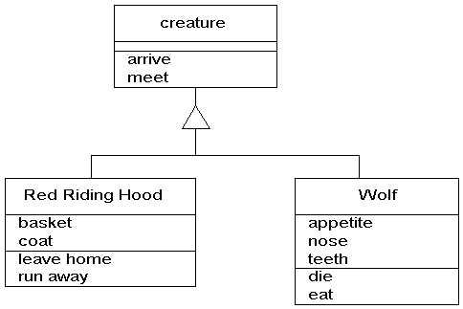
Inheritance means that all the attributes and operations of an abstract object are available in the specialized object below. The triangle in the diagram indicates inheritance. The point of the triangle indicates where operations and attributes are inherited from.

Slide 22
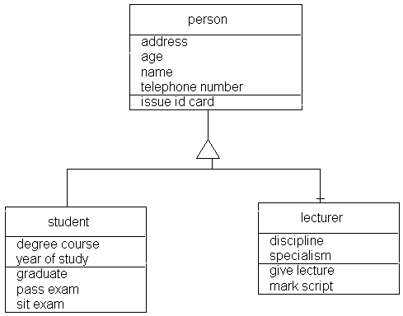
Okay, so let's have some more practical examples for those of you who have to do real work. Firstly, the frighteningly dull student-lecturer example. You can do the same with the equally dull employee-customer example.

Slide 23
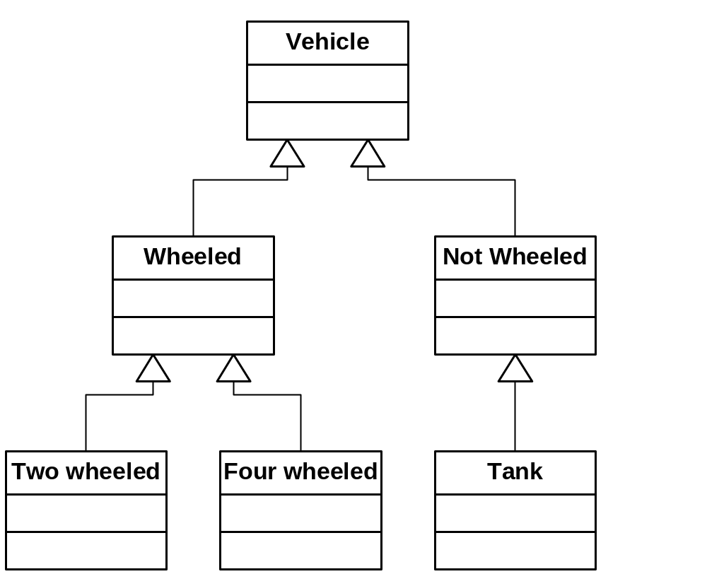
Inheritance
Superclass
Generalization
Class
Specialization
Subclass

Slide 24
What is a Class?
“A description of a set of objects that share the same attributes, operations, methods, relationships, and semantics. A class may use a set of interfaces to specify collections of operations it provides to its environment.”
Hence a class is a group of similar objects

Slide 25
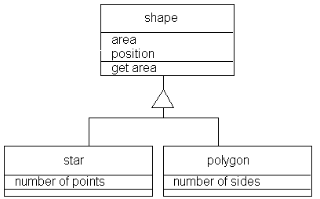

Slide 26

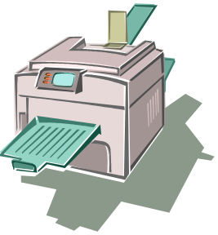
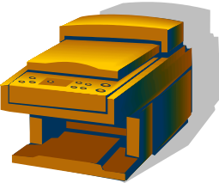

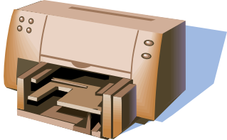

Class Example
Printers
information
behaviour

Slide 27
Attribute
Definition
Attribute is a named property of a class describing a range of values that instances of the class may hold for that property.
An attribute has a type and defines the type of its instances.
Only the object is able to change the values of its own attributes.
The set of attribute values defines the state of the object.

Slide 28
Attribute Examples
object
class
attribute value
:Printer
serialNumber=125t
memory=128Mb
status=idle
attribute
Printer
serialNumber
memory
status
:Printer
serialNumber=067l
memory=256Mb
status=busy

Slide 29
Operation
Definition
Operation is the implementation of a service that can be requested from any object of a given class.
An operation could be:
a question - does not change the values of the attributes
a command – may change the values of the attributes

Slide 30
Operation Example
class
operation
Printer
printFile
stopPrinting
removeFileInQueue

Slide 31
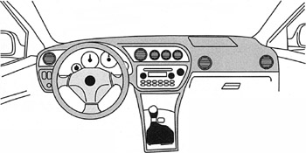
Interface
minimum information required to use an object
allows users to access the object’s knowledge
must be exposed
provides no direct access to object internals

Slide 32
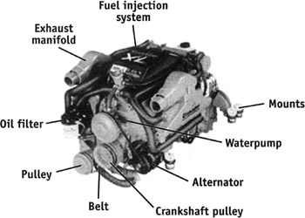
Implementation
information required to make an object work properly
a combination of the behavior and the resources required to satisfy the goal of the behavior
ensures the integrity of the information upon which the behavior depends

Slide 33


